Slide 1
Sample Customer - Software Demonstration
Month Date, Year

Slide 2
Why Choose WorkWave Service?
What are we good at?
Business Unit “Built for Growth”
Own the whole Customer Experience
Integrated Route Optimization
Open API
Vertical Specific Configurations

Slide 3
QuickBooks Integration
Easy Setup for Existing QBs Customers
•Accounts Brought to WWS from QBs
•Products and Services Brought to WWS for QBs
Seamless Transfer after Deployment
•New customers in WWS transfer to QBs
•New Products, Services, Invoices, and Payments transfer to QBs

Slide 4
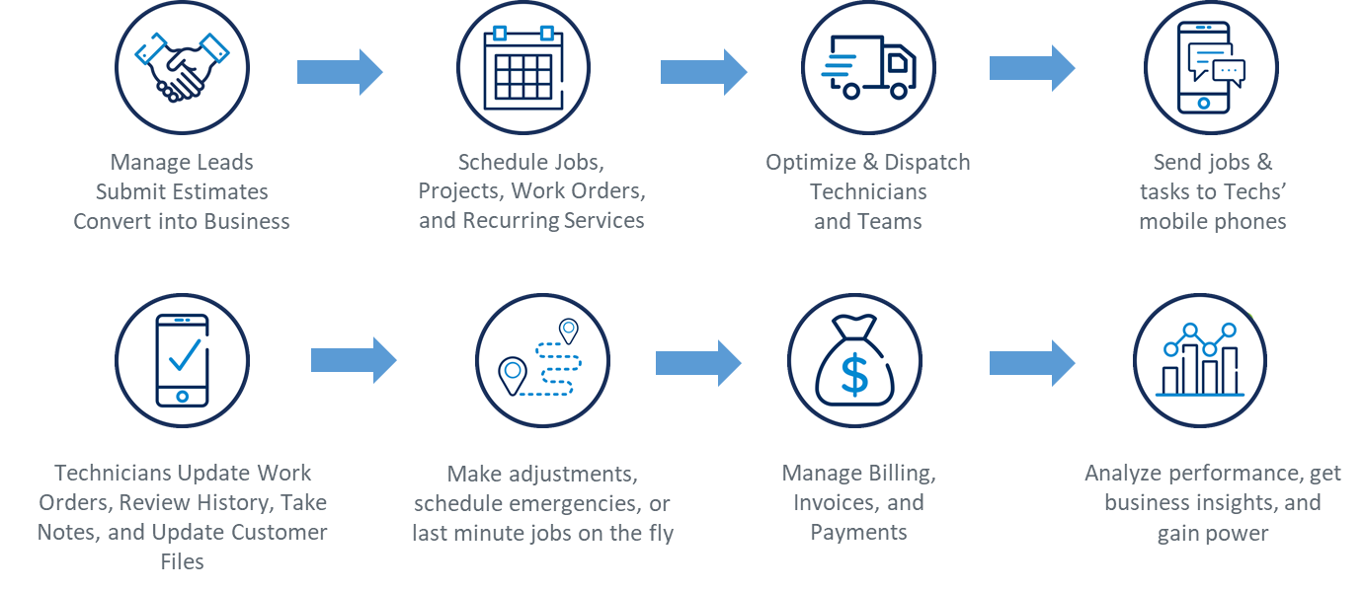
How it Works

Slide 5
Software Demonstration

