Slide 1
Sample Customer - Software Demonstration
Month Date, Year

Slide 2
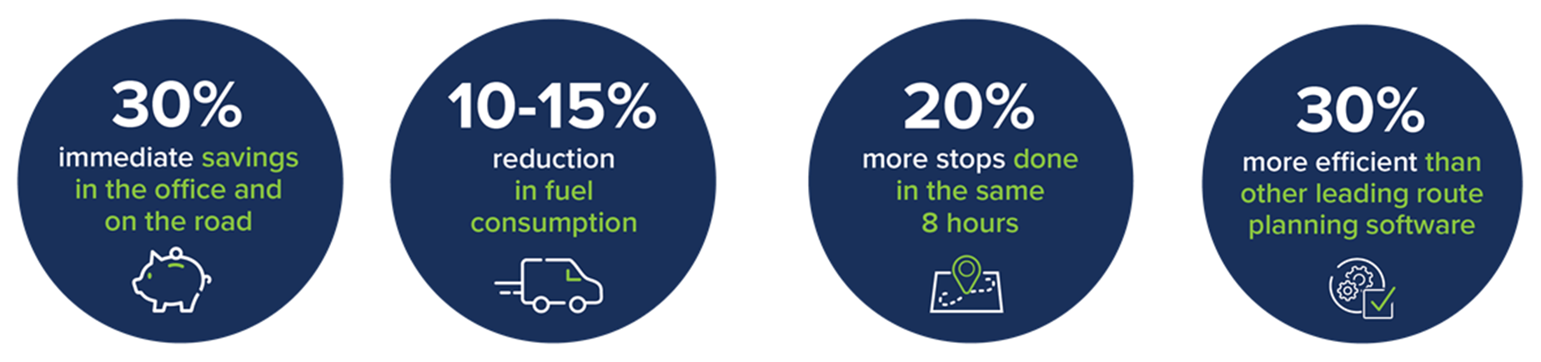
Immediate Benefits of Using Route Manager

Slide 3
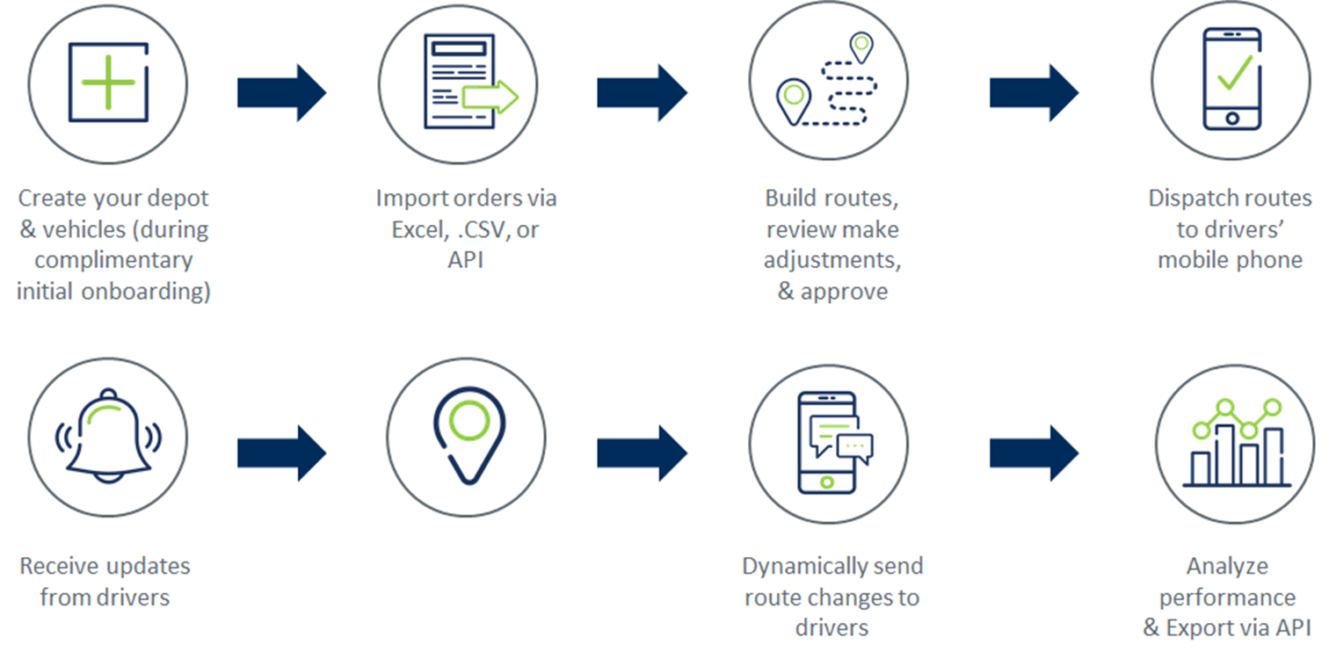
Route Manager - How it Works

Slide 4
Software Demonstration

