Slide 1
WorkWave Service Internal Training
Reporting and Data Management

Slide 2
Agenda
Communication Hub
Timesheets
Break
Built-in Reports
Custom Reports
Reviews
Online booking
Q&A

Slide 3
Communication Hub

Slide 4
Communication Hub
Contains all configurations for customer-facing messaging
Canned Messages
Custom Templates
Users can set recurring or one time message “blasts” to contacts
Text message features require Professional tier
Text messages will respect timeframe setting in company setup

Slide 5
Merge Fields
Contact | Work Order | Invoice | Payment | Service Location
@@COMPANY_NAME@@ | @@SERVICE_DATE@@ | @@INVOICE_DATE@@ | @@PAYMENT_DATE@@ | @@SERVICE_LOCATION_NAME@@
@@COMPANY_PHONE@@ | @@SERVICE_TIME@@ |  |  | @@SERVICE_LOCATION_ADDRESS@@
@@COMPANY_EMAIL@@ | @@LAST_SERVICE_DATE@@ |  |  | @@SERVICE_LOCATION_CITY@@
@@CUSTOMER_NAME@@ | @@LAST_SERVICE_TIME@@ |  |  | @@SERVICE_LOCATION_STATE@@
@@CUSTOMER_FIRST_NAME@@ | @@RESOURCE_NAME@@ |  |  | @@SERVICE_LOCATION_POSTAL_CODE@@
@@CUSTOMER_LAST_NAME@@ |  |  |  | @@SERVICE_LOCATION_COUNTY@@
 |  |  |  | @@SERVICE_LOCATION_COUNTRY@@

Slide 6
Communication Hub
Canned Messages – Simple alerts triggered by a system action

Slide 7
Communication Hub
Templates – used for more generic messaging
Marketing
Account updates
Internal reminders
Fully customized
Can be assigned to a business unit

Slide 8
Communication Hub
Communications – recurring or one time sends of messages
Who is getting the message?
What template is being sent?
Where is the recipient viewing it?
When does it launch?
Why is this being sent?

Slide 9
To WorkWave Service!

Slide 10
Break

Slide 11
Timesheets

Slide 12
Timesheets
Allows employees to start/end their day, log breaks and time off
Allows managers to review productivity, approve time, and prepare reports for payroll
Timesheets must be enabled
Users must be set up to use time sheets on their employee profile
Settings for paid breaks and display settings can be modified

Slide 13
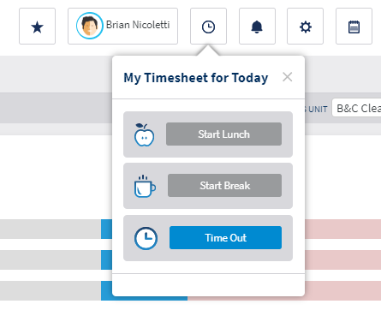
Timesheets – for Employees
Integrated into mobile app
Start day upon login
Tap clock icon to add events or sign out
Clock widget on web app

Slide 14
Timesheets – for Managers
Managed from the Employees tab
Similar workflow to reconciling and closing work orders
Review time sheets submitted
Make manual adjustments as needed
Check off and close individually or in bulk
Can be re-opened if new edits are needed

Slide 15
To WorkWave Service!

Slide 16
Billing Reports

Slide 17
Reporting in WorkWave Service
Various report formats are available for all users
Billing
Scheduling
Timesheet
Activity
Data Lists
Report Writer integration requires professional license

Slide 18
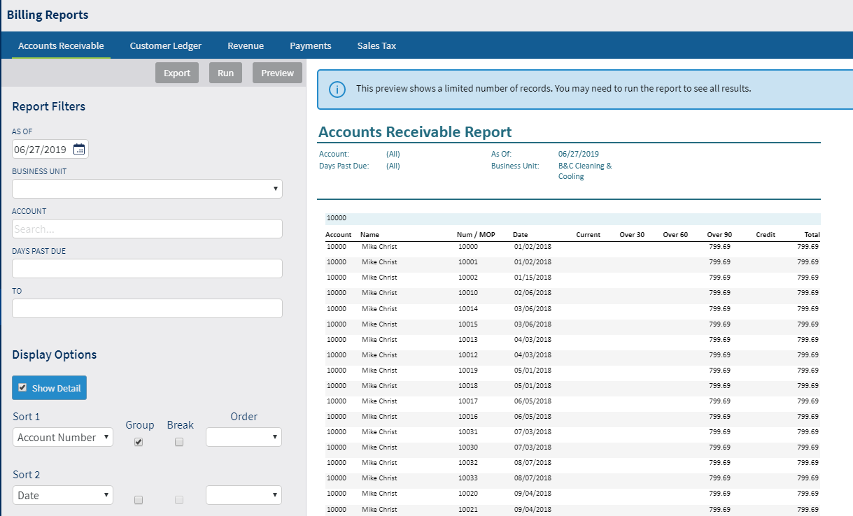
Billing Reports
Accounts Receivable Report
Documents outstanding invoices
Displays 30/60/90 debt milestones

Slide 19
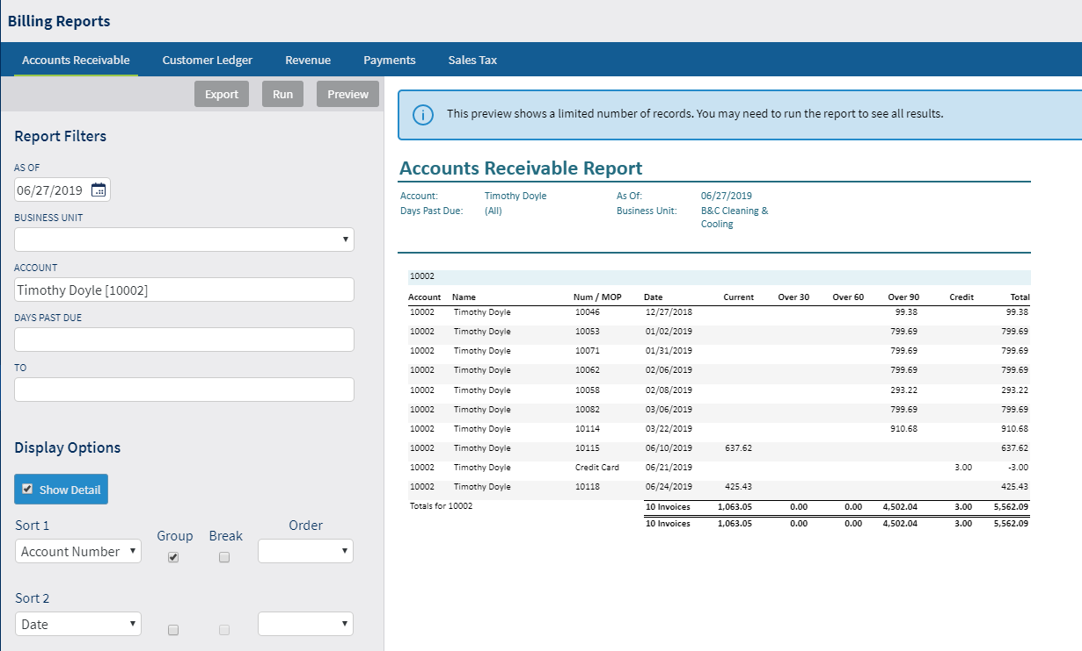
Billing Reports
Customer Ledger Report
Invoice history for a single account
Includes reference number of logged payment

Slide 20
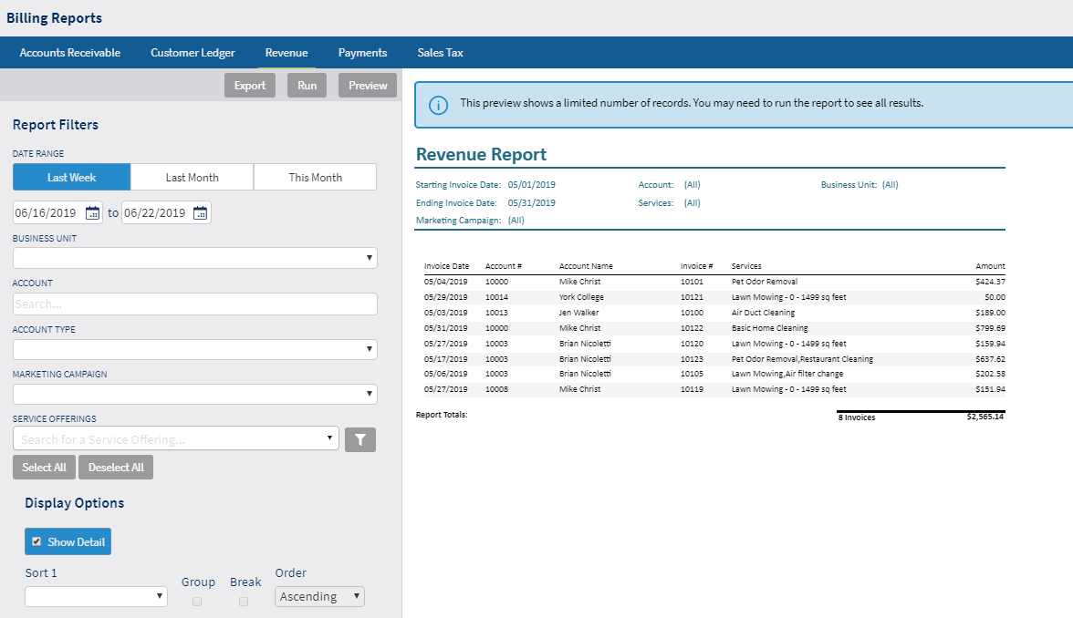
Billing Reports
Revenue Report
Shows all invoices generated in a date range
Filters to see results for campaign, account type, or service offerings

Slide 21
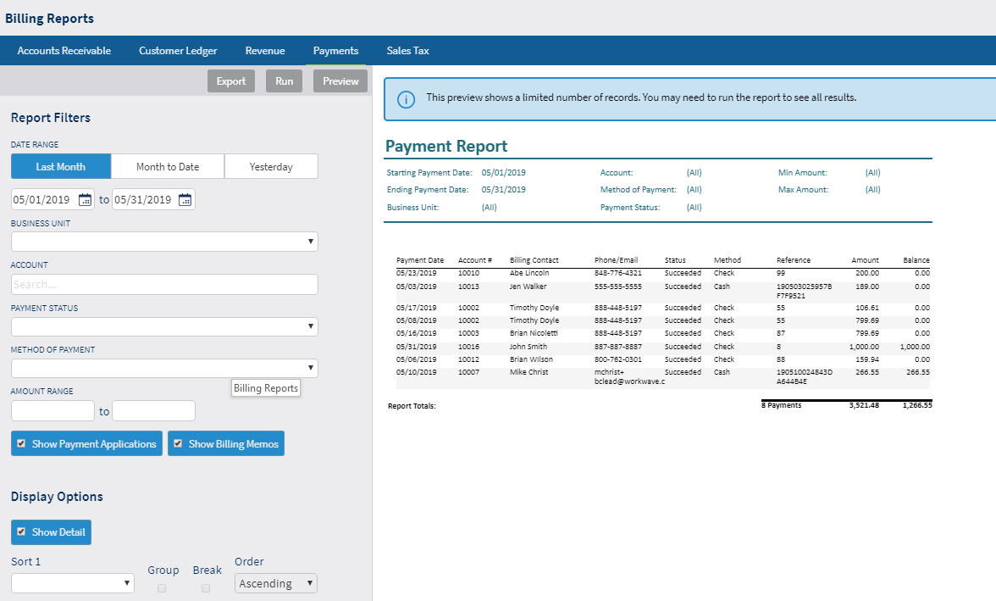
Billing Reports
Payments
Log of all payments processed in a date range

Slide 22
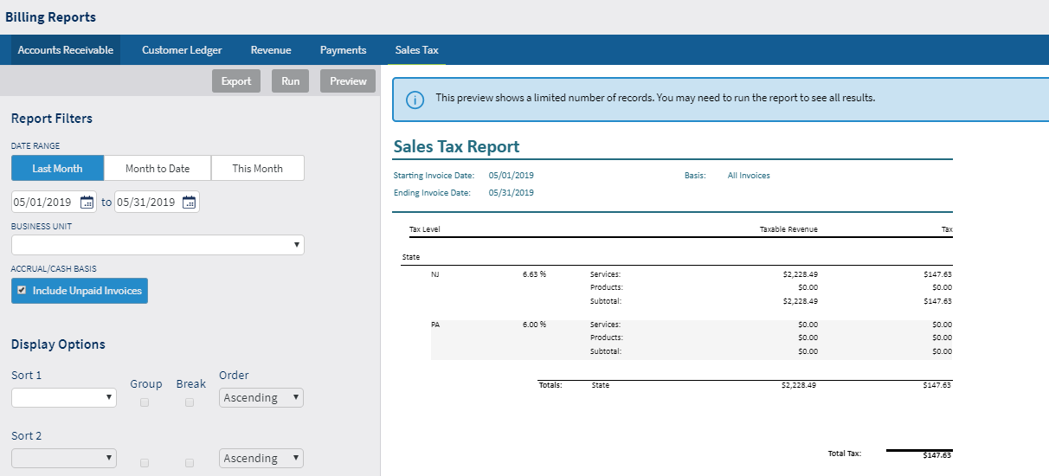
Billing Reports
Sales Tax
Itemized report calculating total of sales tax collected
Can be configured to include unpaid invoices

Slide 23
Scheduling Reports

Slide 24
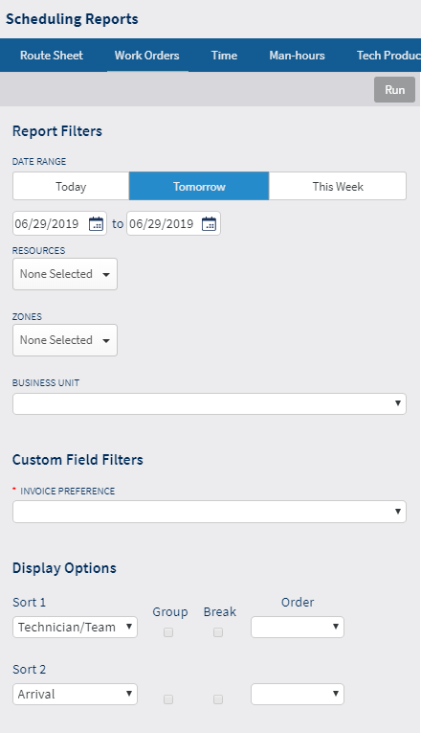
Scheduling Reports
Route Sheet
List of all scheduled work orders for a date range
Can be filtered with custom fields
Displays service descriptions
Does not include service memos

Slide 25
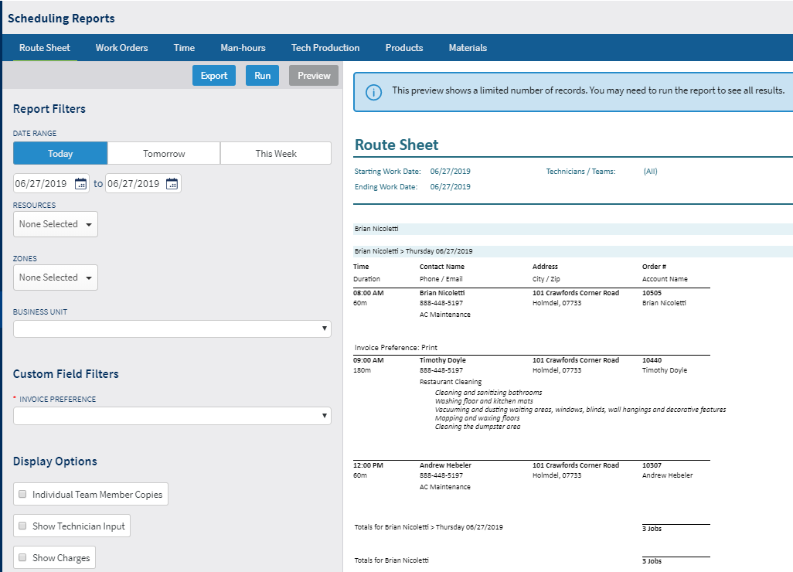
Scheduling Reports
Work Orders
Detailed work orders for a date range
Can be filtered with custom fields
Can include area for customer signature
This and previous “report” can also be generated from calendars

Slide 26
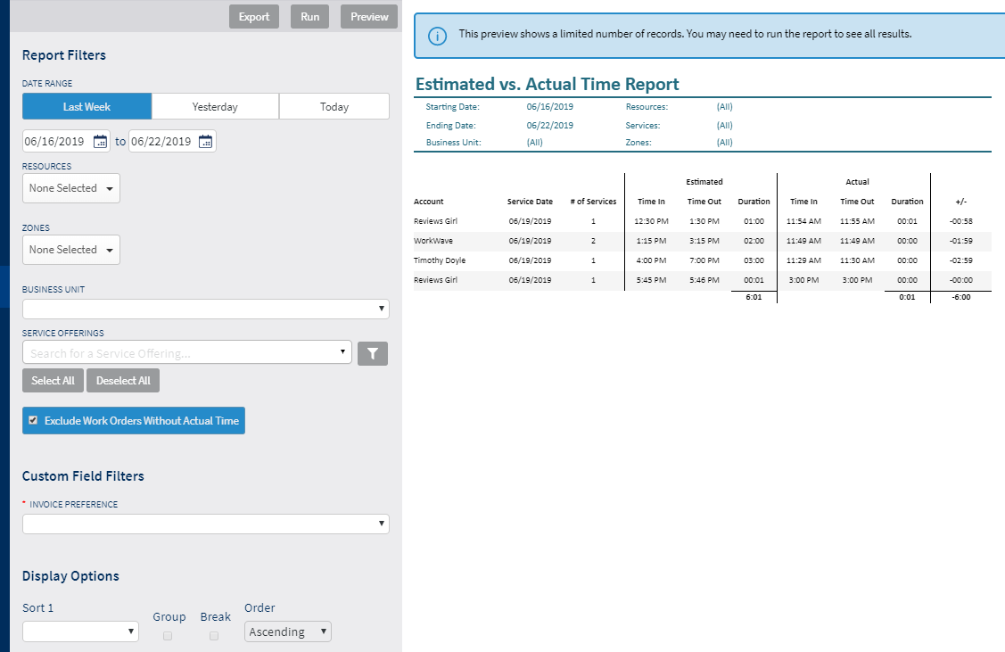
Scheduling Reports
Time
Calculates Estimated vs. Actual time
Dependent on work orders having time logged

Slide 27
Scheduling Reports
Time
Calculates Estimated vs. Actual time
Dependent on work orders having time logged

Slide 28
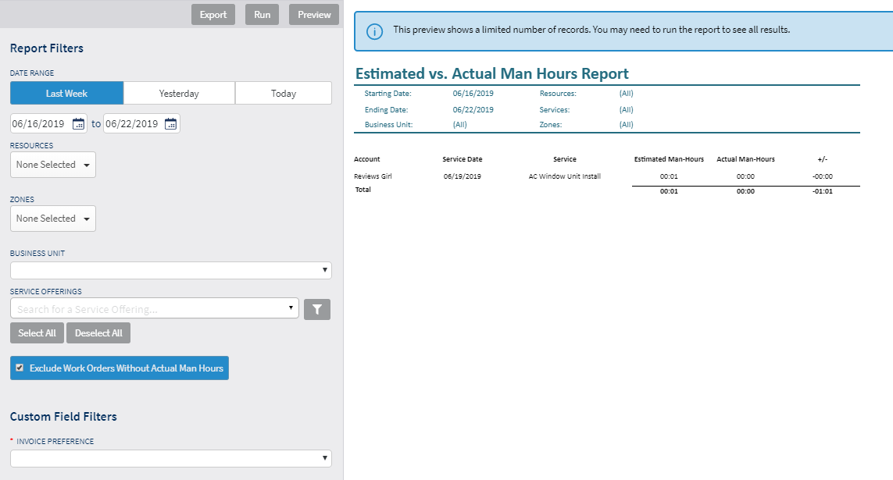
Scheduling Reports
Man Hour Report
Calculates Estimated vs. Actual man-hours
Dependent on work orders having time logged
Dependent on changing work orders to “Use actual man hour pricing”

Slide 29
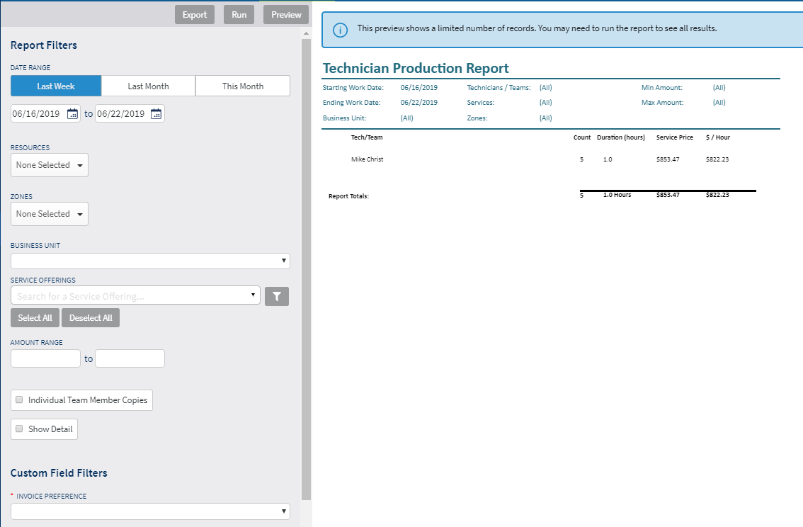
Scheduling Reports
Tech Production Report
Converts the duration and price of a job as an hourly rate for a technician
NOT a payroll report
Commonly used to help determine commissions

Slide 30
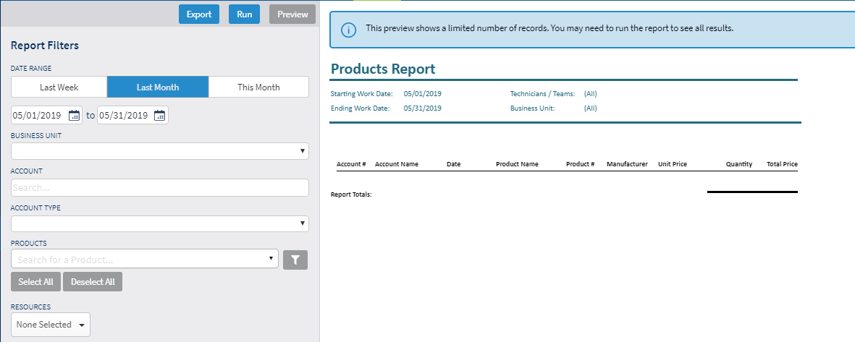
Scheduling Reports
Products Report
What products have I sold in a date range?

Slide 31
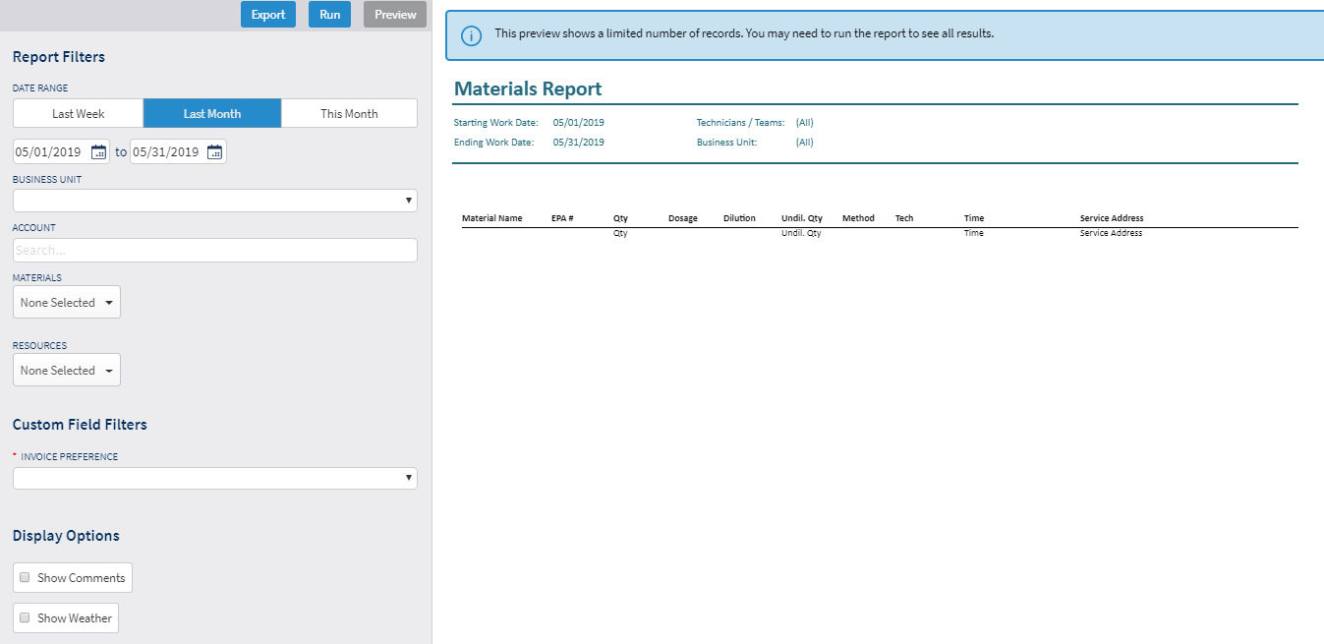
Scheduling Reports
Materials Report
What Materials have I used in a date range?

Slide 32
Timesheet Reports

Slide 33
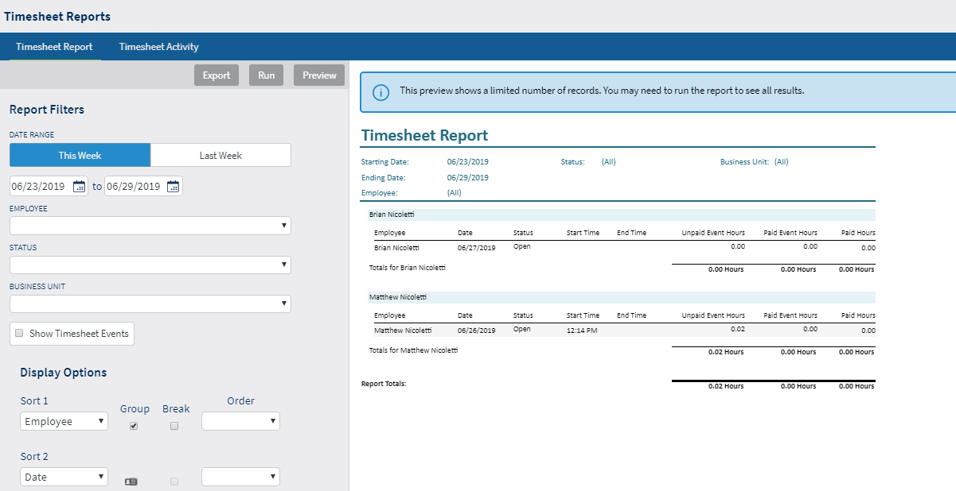
Timesheet Reports
Timesheet Report
How many paid hours did a tech work in a date range
Requires timesheets to be submitted (by tech) and approved (by admin)

Slide 34
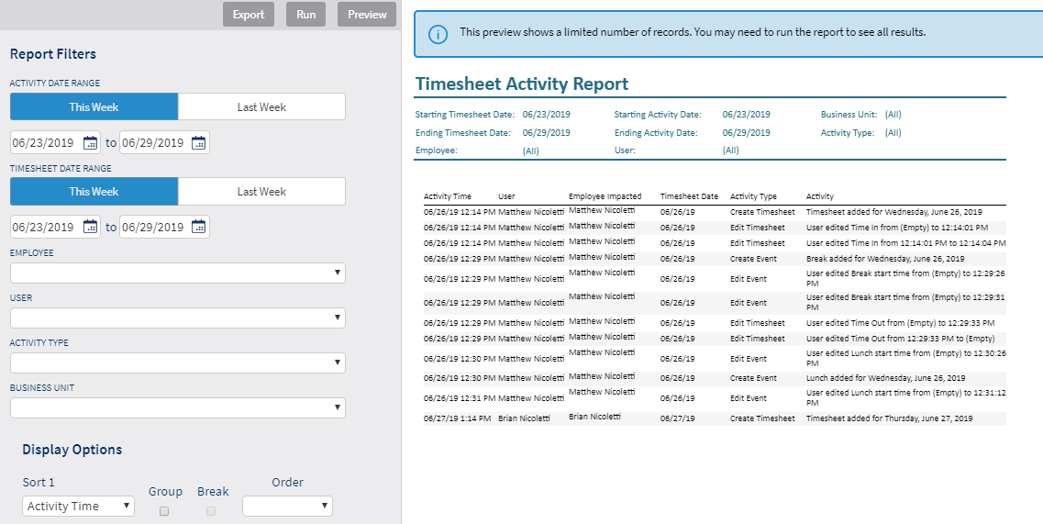
Timesheet Reports
Timesheet Activity
Data dump of timesheet interactions by users

Slide 35
Activity Report

Slide 36
Activity Report
Activity Report
Data dump of account interactions by users
Excludes many things (agreement changes, mobile logins, account changes)

Slide 37
Lists

Slide 38
Data Lists
System data segmented in “buckets”
Accounts
Service locations
Agreements
Renewals
Work Orders
Invoices
Payments
Leads
Opportunities

Slide 39
To WorkWave Service!

Slide 40
Report Writer

Slide 41
Report Writer
Third-party tool, white labeled for WorkWave
Can be utilized within WWS or from a separate UI
Allows users to take many data points from WWS and create dashboards, pivot tables, formula-based reports, charts and graphs
WorkWave can create custom reports with RW for users as a service

Slide 42
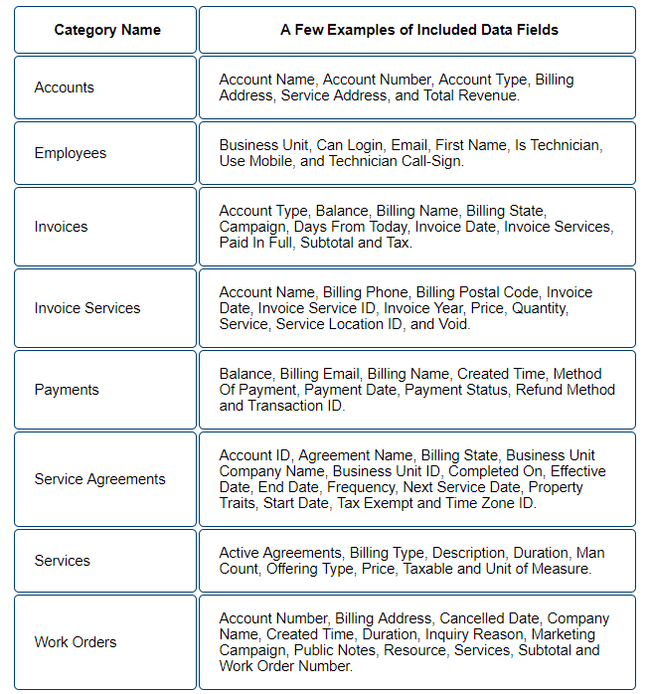
Report Writer

Slide 43
To WorkWave Service!

Slide 44
Business Reviews & Service Reviews

Slide 45
Reviews in WWS
Add-on module (AKA ContactUs)
Provisioned and implemented by Marketing Success team (Mike/Jaime)
Separate platform that integrates with WWS via API
Reviews can be automated (upon job closing) or triggered manually
Rule of thumb:
Service Reviews = Internal
Business Reviews = Public

Slide 46
Service Reviews
After a service is closed, sends an email to customer with survey
Rate technician (1-5 stars)
Rate the service (1-5 stars)
NPS rating (1-10)
Provide a comment
User is notified of survey response with email alert
Surveys are aggregated and reported on in ContactUs platform
Service reviews display on account history

Slide 47
Business Reviews
After a service is closed, sends an email or text to customer with Link
Review on “our website”
Facebook
Google
BBB
YP
User is notified of Review with email alert
Reviews can be replied to in ContactUs platform
Business reviews display on account history & dashboard

Slide 48
To WorkWave Service!

Slide 49
Online Booking

Slide 50
Online Booking
Professional tier feature
Allows users to provide a link where potential customers can request service
Does not commit work to schedule
Creates opportunity
Provides notification

Slide 51
Online Booking
Workflow
Enable Online Booking on Company Settings
Create the online booking window
Create Issues (“what can we help you with”)
Select the services that are available to be booked online
Share your online booking link
Manage your booking requests

Slide 52
To WorkWave Service!

Slide 53
Recap
WorkWave Service has a suite of built in reporting that will help users find important data to better run their business.
Users can rely on lists to find any sort of search query or see larger data sets at a glance.
Report writer can be leveraged for advanced reporting solutions.
All customer messaging can be customized to grow business or maintain relationships with customers.
Modules can be used with WWS to enhance it’s benefit to a business.

Slide 54
Questions

Slide 55
Thank You!

