Slide 1
WorkWave Service Internal Training
Using WWS in the Field

Slide 2
Agenda
Licensing and Permissions
WWS Mobile App
WW GPS
WWS for the Non-technical
Action Items

Slide 3
Who Uses WWS In The Field
This Photo by Unknown Author is licensed under CC BY-SA

Slide 4
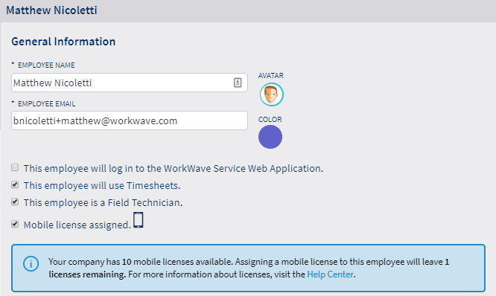
Allocating Mobile Licenses
Controlled from Employee Profile

Slide 5
WorkWave Service Mobile App
Compatible with Android and iOS
Users pay per license
Syncs in real time – pushes notifications for schedule updates
Encrypted connection
Offline mode*
Technician-focused application
Does not provide office-centric functionality
Does not track technician location in real time

Slide 6
WorkWave Service Mobile App
Manage work order schedule
Contact customers
Communicate with office
Create leads
Sell services and products
Log payments
Track productivity

Slide 7
To WorkWave Service Mobile!

Slide 8
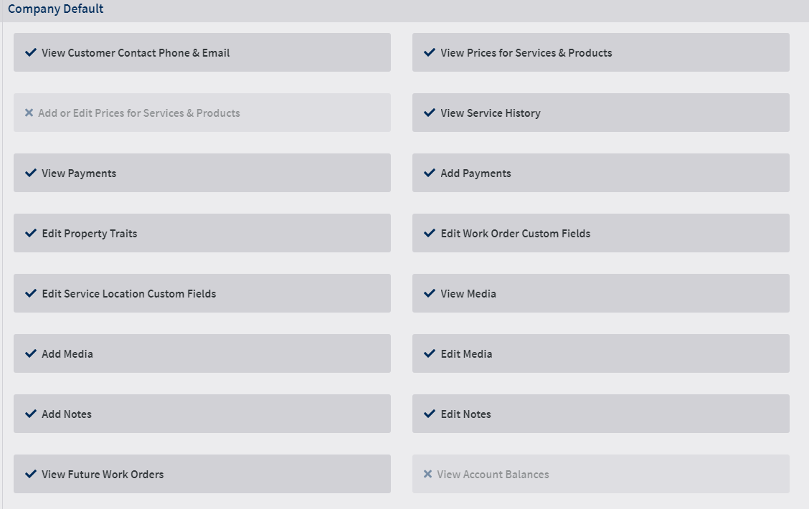
Adjusting Mobile Permissions
Users can allow or restrict mobile permissions from Settings → Permissions and Roles → Mobile Options

Slide 9
WorkWave GPS

Slide 10
WorkWave GPS
Standalone product with integration in WWS
Hardwired or plug-and-play units for vehicles
Also comes with standalone UI
All management features maintained in WWS

Slide 11
WorkWave GPS Setup
GPS Credentials added to Settings → Application → GPS
GPS devices can be given a label tag
Speed thresholds can be set up per device

Slide 12
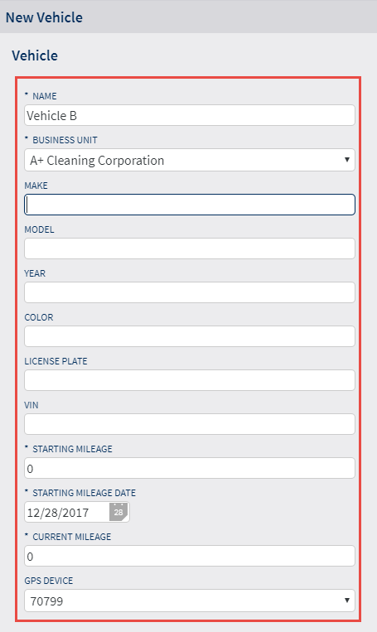
WorkWave GPS Setup
Vehicle details added in My Company → Vehicles

Slide 13
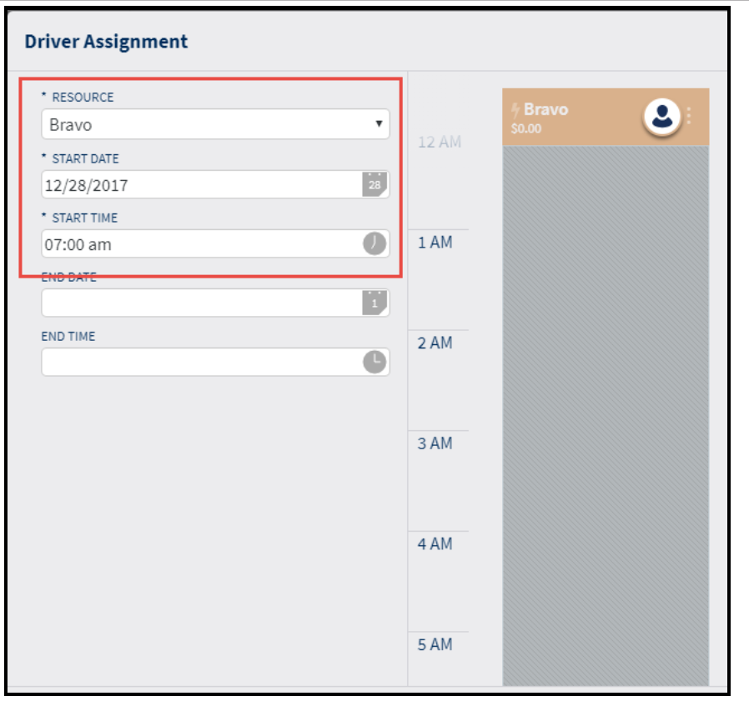
WorkWave GPS Setup
Driver (tech) added to vehicle

Slide 14
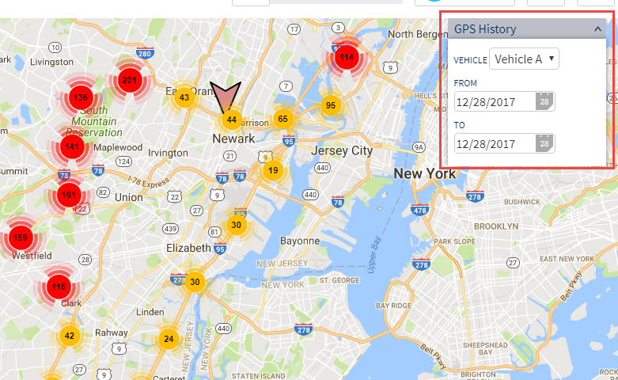
WorkWave GPS
GPS History logged on map

Slide 15
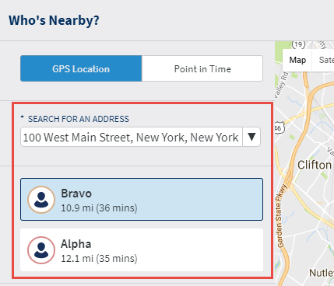
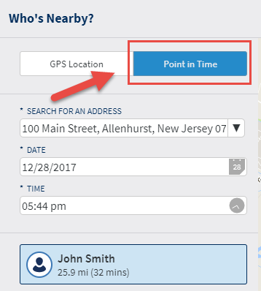
WorkWave GPS
“Who’s Nearby” setting added to dispatch board

Slide 16
Non-technical Solutions
Reporting → Scheduling Reports
Route sheet for a day
Individual work orders for a technician
Service reports have to be generated from account history and emailed or printed
Breaks and lunches need to be logged manually into timesheets

Slide 17
Recap
The WorkWave Service Mobile App is the ideal solution for technicians to manage their day-to-day operations in the field
Administrators and office staff can stay in sync with mobile techs at any point with notes and schedule updates.
WorkWave GPS can be fully managed and implemented in WWS.
WWS has a manual solution for everything mobile offers – but mobile makes it all easier!

Slide 18
Action Items

Slide 19
Action Items
Get the app! (Your phone/Tech ops device library)
Get a GPS demo account! (Doug or Hailey M)
Go old school!

Slide 20
Thank You! Session Playlist

