Slide 1
WorkWave Service Internal Training
Managing the Schedule and Finances

Slide 2
Agenda
Managing Upcoming Work
Managing Finished Work
Action Items

Slide 3
Viewing Jobs
Appointment Calendar
Shows visual display of daily work orders by tech
Dispatch Board
Shows same data, but with a Here Maps overlay
Work Order List
Pre-built filters to show current day, next day, next week, previous day

Slide 4
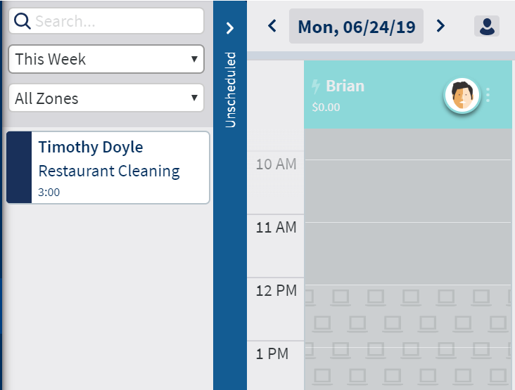
Job Status at a Glance
Unscheduled Jobs
Found on the side bar
Filters by time and zone
Searchable for name and service
Jobs can only be dragged one at a time

Slide 5
Managing Jobs on the Calendar View
One at a time
Pop up has buttons to cancel or reschedule
Within the same day
Drag and drop to place on different tech
Stretch and drag to change estimated time
For an entire route
Sub-menu next to avatar can reschedule or unschedule an entire route.
For recurring jobs, option to reschedule following jobs or single.

Slide 6
Other Icons
Customizing views
Printing/Emailing
Team Assignments
Commitment lock

Slide 7
To WorkWave Service!

Slide 8
Job Sub Status
User defined criteria that serves as a way to better describe the overall progress of a Work Order.
Associated with a parent status and assigned by the on the work order via dropdown
Defaults can be associated.
Use Case: Users can set a sub-status of “Need to order parts” for the parent status “Completed.” This will help them report on jobs that will need to have follow up later on with another work order.

Slide 9
Route Optimization
Premium feature – comes at higher account tier
Direct algorithm – Looks at service address, estimated duration, start & end of route, and fits in as many work orders in the day as possible.
Respects the service hours defined in settings
Can incorporate unscheduled work
Provides preview before committing changes
Changes can be made after route is optimized
Single day optimization only

Slide 10
To WorkWave Service!

Slide 11
Commitments
Commitments are a way for users to “lock” the appointment time
Customer response can be logged manually
Users can also email/text a confirmation request to customer (premium feature)
Can be done for jobs individually, or for the entire day
Jobs can still be rescheduled even if committed – status is yellow

Slide 12
Let’s Close Jobs!

Slide 13
Background
Closing a work order is the only way that WWS knows the job has been finished
Jobs can only be closed manually via Billing 🡪 Work Orders

Slide 14
Reconciling Work Orders
Reconciling allows users to make any final changes to the work order before closing
Adding/removing services
Applying discounts
Moving appointment
Adding/reviewing notes
Updating team assignments
Logging time in/time out
Switching to man-hour pricing
Resetting started appointments

Slide 15
Closing Jobs
The close view consolidates jobs by day and technician
Checkboxes allow for individual closure, or to be done in bulk
For “on completion” agreements, closing generates invoice
For billing cycle agreements, closing puts the job in the history
On demand jobs get closed and added to additional queue for invoicing

Slide 16
To WorkWave Service!

Slide 17
Managing Invoices
Invoices show in Billing 🡪 Invoices, consolidated by the day they were generated
Invoices can also be found on the account history
Invoices can be printed or emailed to customers individually or in bulk
Invoice content can be configured via the Reports and Forms setting

Slide 18
Managing Invoices
Mistakes happen!
Invoices can be voided entirely (e.g., I closed an order that should have been cancelled)
Invoices can be reissued with corrections (e.g., I forgot to apply a discount and the price is wrong)
Voided invoices will be sent to Quickbooks (if setup)
Re-issued invoices will have a new number, but have date of original service

Slide 19
Applying a Payment to an Invoice
Payments are logged in Billing 🡪 Payments
User must search the account or invoice number to log payment
Partial or full payment can be applied to balance due
Receipt can be sent to customer for logged payment
If payment is received prior to service, it will be logged as a credit on account

Slide 20
To WorkWave Service!

Slide 21
WorkWave Payments Integration
WWP Account information added to Settings 🡪 Integrations
Unlocks options during agreement and on account to securely add a bank account or credit card
This payment source can be selected during the Payment screen

Slide 22
WorkWave Payments Integration
Agreements can be set up to pre-authorize payment for an agreement
When live, this will tentatively charge the source for the amount of the invoice
Users must review these payments and approve or reject from Billing 🡪 Payments 🡪 Bulk Payments

Slide 23
Recap
Users have full management over choosing when a job can be scheduled, or let the system decide via route-op
Covered several resources for office to see the daily schedule, add additional functions for better insights, and how to make small or large changes
Explained how to manage and complete jobs that are ready to be billed, and how to provide the invoice to customers
Reviewed how payments can be applied to balances due, and how mistakes can be revised

Slide 24
Action Items

Slide 25
Action Items
Reconcile work orders with times
Review all of the ways pricing for a completed work order can be adjusted
Close work order and send invoice to customer who already payed (zero balance remaining)
Explain ways how to reschedule an entire route for an employee who's car breaks down

Slide 26
Thank You! Session Playlist

